Slide 1
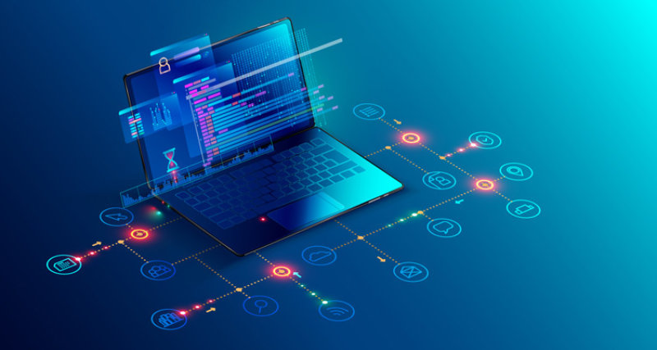

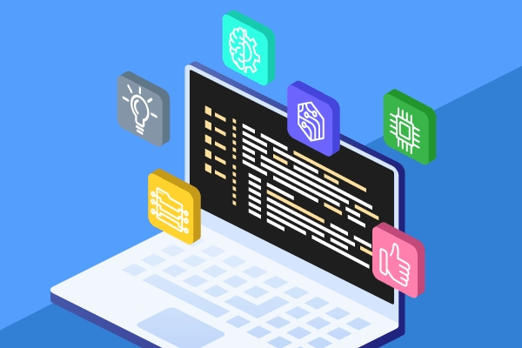
Software Development Project
VISHWAKARMA INSTITUTE OF TECHNOLOGY,PUNE
S.Y. B -Tech Electronics and Telecommunication
A.Y. 2021-2022

Slide 2
EnTc D-division Batch -1 Group : 5
ROLL NO | NAME | GR NO.
18 | Akash Shekhavat | 12011086
19 | Madhuri Shelke | 12010769
20 | Chetan Shinde | 12011223
21 | Samiksha Shinde | 12010839

Slide 3
PROJECT TITLE
Student Helper Website

Slide 4
O U T L I N E
Objective
Domain
Tools and Technology
Results and Discussion
Conclusion
Future Scope
References

Slide 5
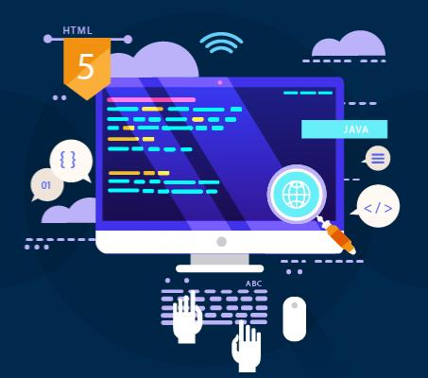
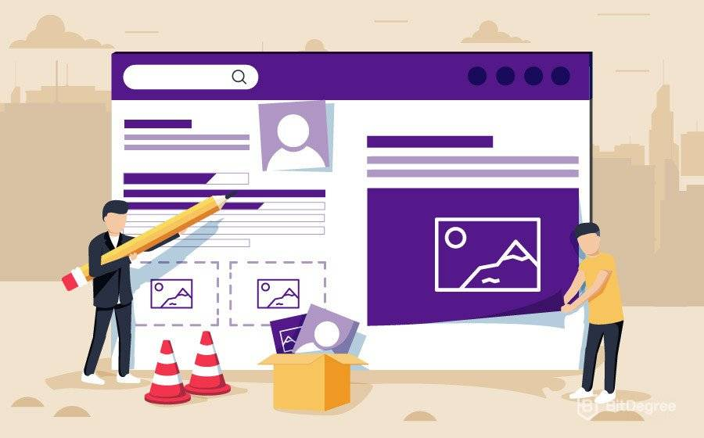

OBJECTIVE
Student Helper Website
Creation of an interactive website.
To provide ease in the online admission process for the freshers.
Solving queries of students related to the activities of the college.
Providing information about the events taking place in the college.

Slide 6

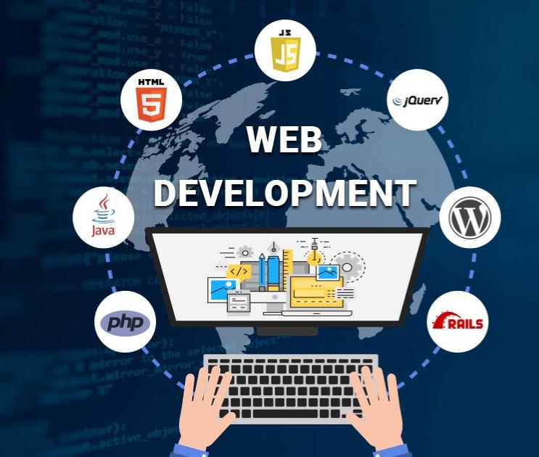
Domain
Web Development
Web development is the work involved in developing a Web site for the Internet.
It includes aspects such as web design, web publishing, web programming, and database management.
It is the creation of an application that works over the internet i.e. websites.
Web Development can be classified into two ways:
Frontend Development Backend Development

Slide 7




TOOLS & TECHNOLOGY
Languages used
HTML
CSS
JAVA SCRIPT DJANGO
IDE Used
Visual Studio Code

Slide 8
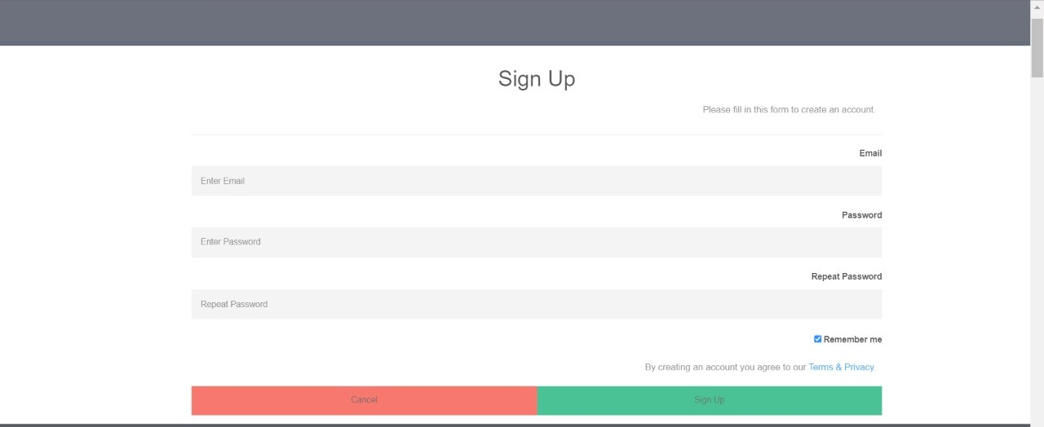
Login page
Results & Discussion

Slide 9
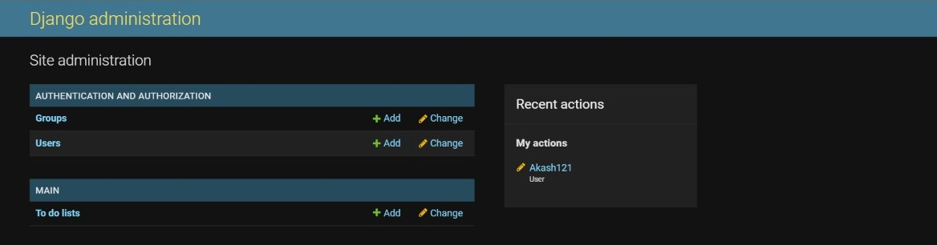
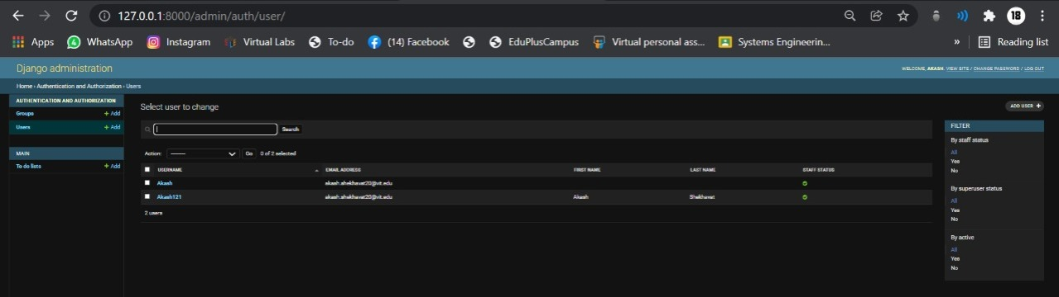
Admin page

Slide 10

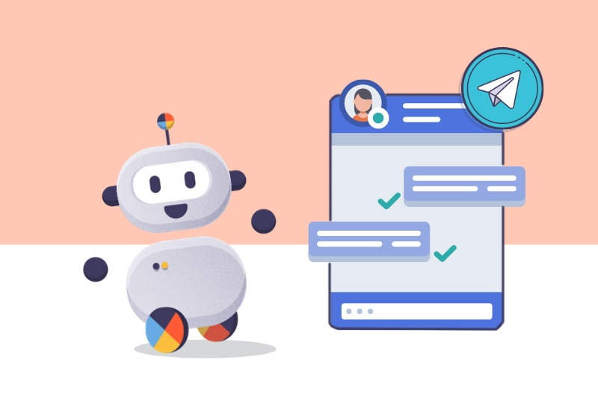
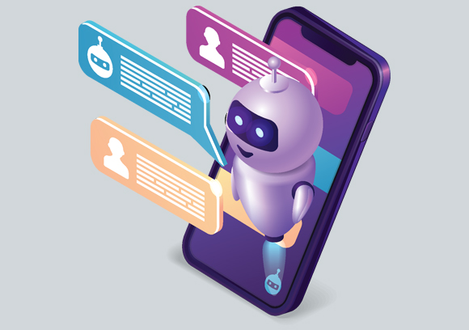
CHATBOT
A chatbot is a type of software that can automate conversations and interact with people through messaging platforms.
A chatbot is a computer program that’s designed to simulate human conversation.User communicates with these tools using a chat interface just like they would converse with other. Chatbots interpret the words given to them by a person and provide pre-set answer. Chatbots boost operational efficiency by being available 24x7.

Slide 11
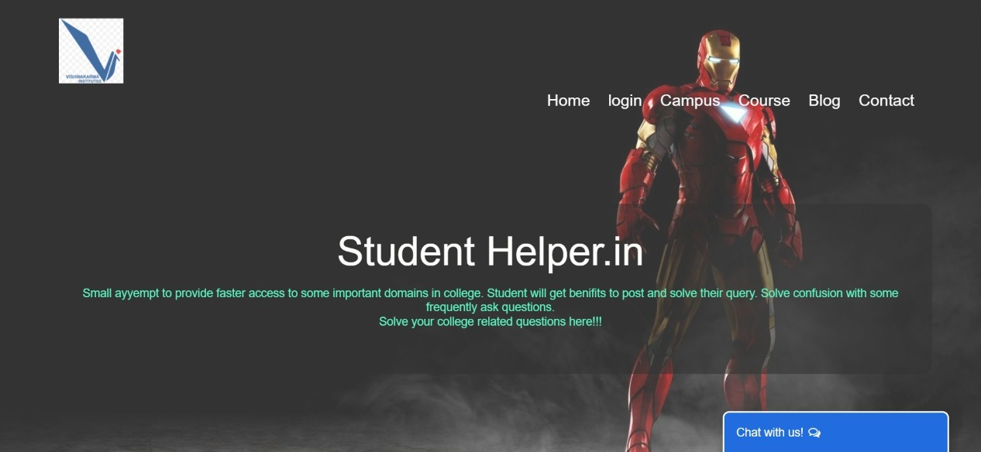

Home page

Slide 12
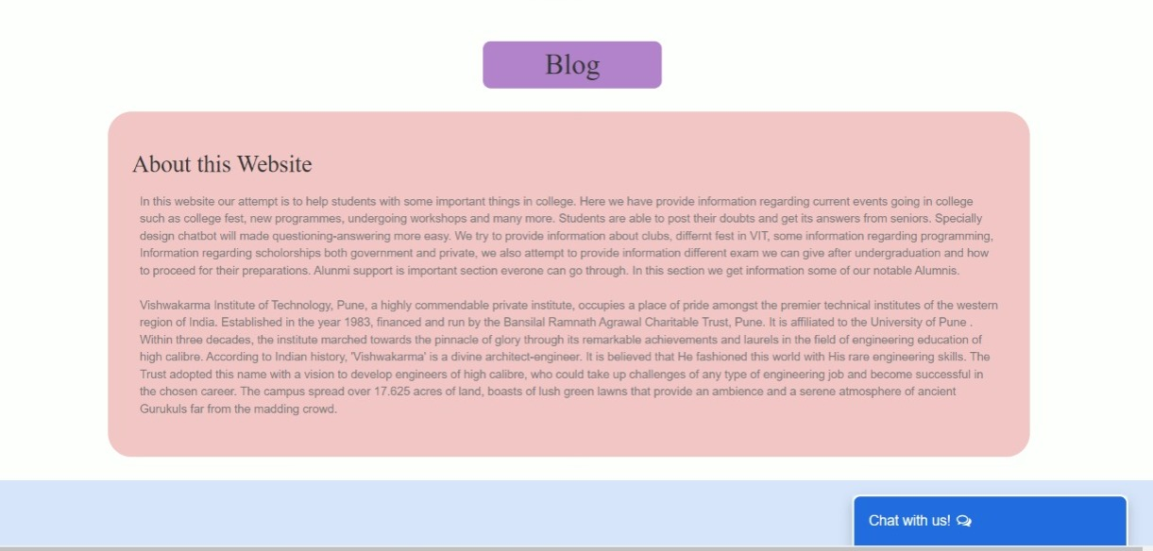
About page

Slide 13
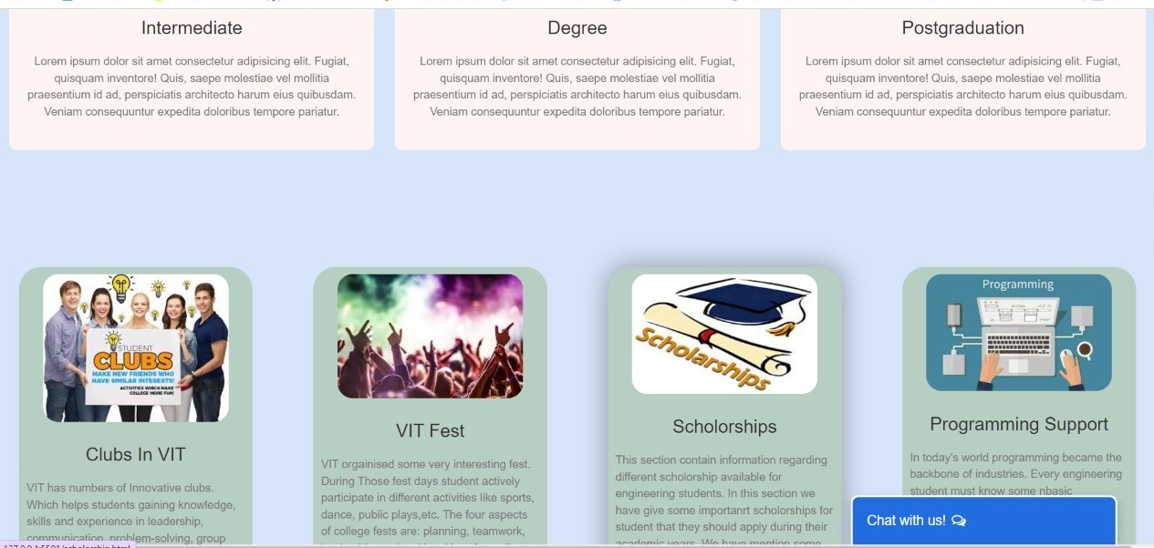
Portfolio page

Slide 14
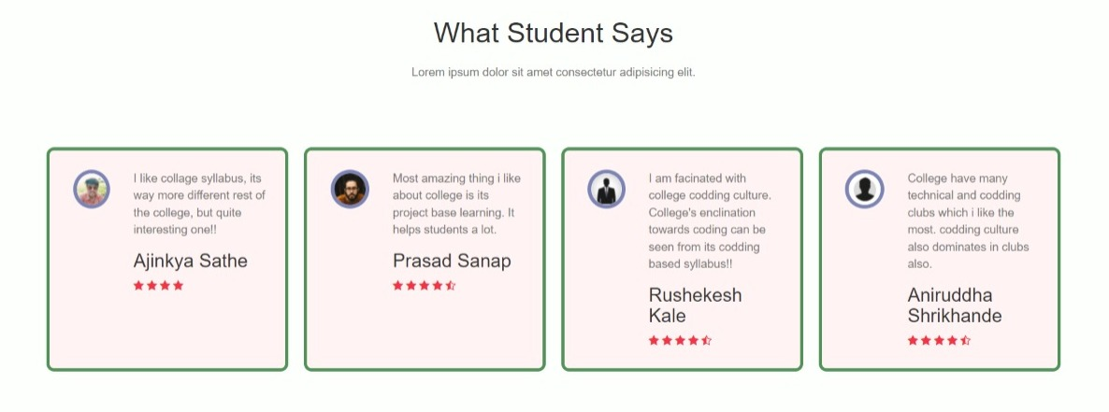
Review Page

Slide 15
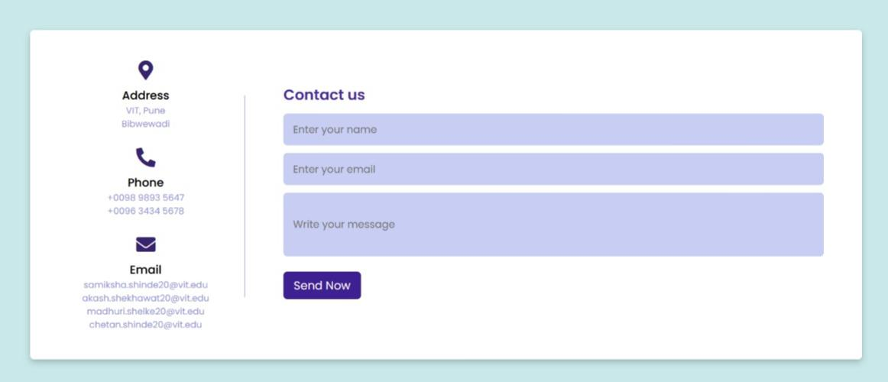

Contact page

Slide 16
Conclusion
The goal of this system is to help the students to stay updated and get the answers related to their college activities .
It is advantageous for international applicants for queries such as fee payment and academic matters.
Students can get the information at their fingertips rather than visiting college office.

Slide 17

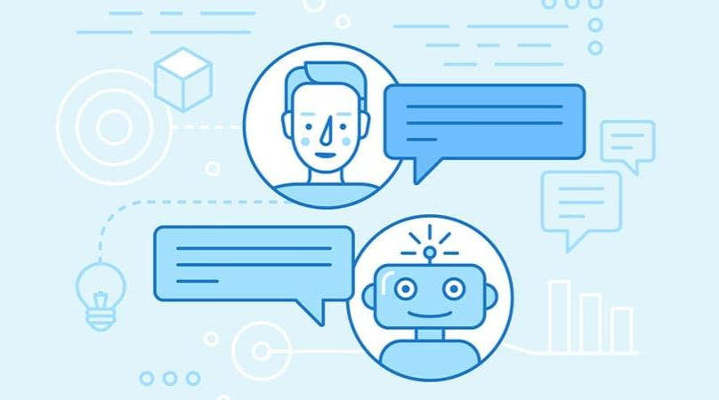
Future scope
More data could be added regarding different departments.
We can include voice based chatting. User only have to ask query in voice format and then chatbot will give response in voice format with simultaneously showing response in text format on screen.
In this project we can also include some AI functionality from which chatbot can also find answers from internet.
Integration with multiple channels such as phone call, SMS , email can be done.

Slide 18
References
IJERT_College_Enquiry_Chat_Bot_Systema.
tes and its Usability.
College Enquiry Chatbot Report_v12a.
IJERT_College_Enquiry_Chat_Bot_System.
The Importance of Higher Education Websites and its Usability.

Slide 19
THANK YOU!!!

